Slide 1
Welcome to Curriculum Night 2021/2022
Ken Murray
English 7
Classes:
703, 706, 707, 708
*COVID-19
Edition

Slide 2
* Communication
- Course Outline
- Class Website
- Google Classroom
Curriculum
- Hyperlink provided
Assessment & Evaluation
- Powerschool/Gradebook
- Username & Password
Collaboration
- Working together to ensure success for your child
Questions?
Overview

Slide 3
Communication
E-mail (preferred)
murrayk@hrce.ca
murrayk@gnspes.ca
* MSMS School Website
http://www.msms.ednet.ns.ca/
*Class Websites
http://murraykmsms.weebly.com/
Phone
MSMS 902 832-2300
Direct 902 725 2147
Communication Plan
Link:
https://docs.google.com/document/d/1ddBIyDyhoeeU-y8txRGYWjEULjfpZjM8/edit#

Slide 4
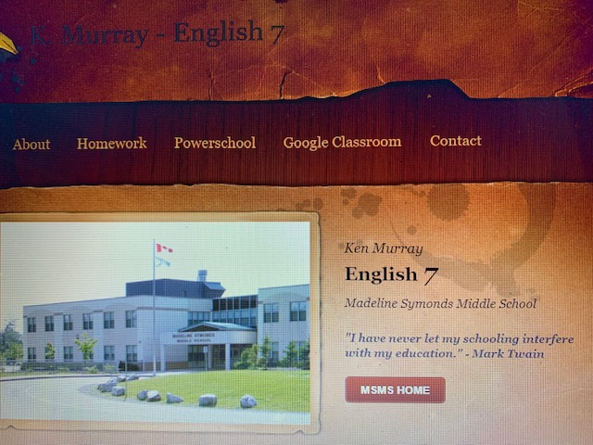
English 7 Murray – Class Website
http://murraykmsms.weebly.com/
English 7 Murray – Google Classroom
*Students have already joined my virtual classrooms. If needed, class entry codes are available from a link on my class website.

Slide 5
Curriculum
Specific curriculum outcomes for each subject can be linked directly from my class website or the MSMS website.
Direct Link: https://docs.google.com/document/d/1ddBIyDyhoeeU-y8txRGYWjEULjfpZjM8/edit#
The next slide is meant to provide a brief summary/outline of some of the ways we might ‘tackle’ various outcomes within the three strands of the English curriculum.
English Language Arts – 3 Strands:
Speaking and Listening
Reading and Viewing
Writing and Representing

Slide 6
* Philosophy
Poetry
5-paragraph essay writing
Novel Study
Response Writing (3 R Method)
Short story analysis
Character Study
Article Analysis
Qualities of Writing (The Six Traits)
The Writing Process
Elements of Fiction (plot, theme, etc.)
Graphic Representations
Independent Reading
Oral Speaking / Presentation Skills
Spot /Quick Writes
Flash Fiction (Story) Writing
English 7
Please read with your child regularly - or have discussions about what he/she is reading. They’re not too old :)

Slide 7
MSMS
4 Point Assessment Rubric
4 (Really Got It!) | In-depth knowledge and understanding of content and concepts. Able to extend the application of related skills.
3+
 | Competent knowledge and understanding of content and concepts. Appropriate application of the related skills.
3 (Got it!)
 | .
2+
 | Developing knowledge and understanding of content and concepts. Developing in the application of the related skills
2 (Not yet! Nearly There!)
1 +
1 (Not yet!)
 | Limited knowledge and understanding of content and concepts. Limited application of related skills.

Slide 8
Achievement of Expected Learning Outcomes Grades 7-12
90 – 100% The student demonstrates excellent or outstanding performance in relation to the expected learning outcomes for this course.
80 – 89% The student demonstrates very good performance in relation to the expected learning outcomes for this course.
70 – 79% The student demonstrates good performance in relation to the expected learning outcomes for this course.
60 – 69% The student demonstrates satisfactory performance in relation to the expected learning outcomes for this course.
50 – 59 % The student demonstrates minimally acceptable performance in relation to the expected learning outcomes for this course.
Below 50% The student has not met minimum requirements in relation to the expected learning outcomes for this course.
Notes:
8
8

Slide 9
Powerschool / Gradebook
It is your ‘portal’ into your child’s academic progress.
It requires a unique username and password .
(This carries forward yearly but requires resetting occasionally.)
To obtain or retrieve a username and password, please email a request to the office. ☺
(We are not allowed to send it home with the student.)
https://sishrsb.ednet.ns.ca/teachers/gradebook/home.html

Slide 10
Google Apps for Education
GNSPES
For most assignments, your child will also have access to my virtual classroom.
They have been provided a GNSPES username and password.
(It is a combination of their initials (mkg) and the last six digits of their student ID)
http://gnspes.ca/

Slide 11
Working Together
- Monitor homework… “talk” with child about school and monitor
class websites and Google Classroom - Monitor your child’s progress… track effort and performance (PowerSchool) - Encourage routines… homework habits, organizational support, reading - Provide support with homework… if necessary - Sign all tests/quizzes/rubrics… there should be no surprises! - Read notices, sign, and return ASAP… when necessary - Communicate / Ask Questions… email, phone, websites - Model, promote, and encourage reading!
Read, Read, Read!!

Slide 12
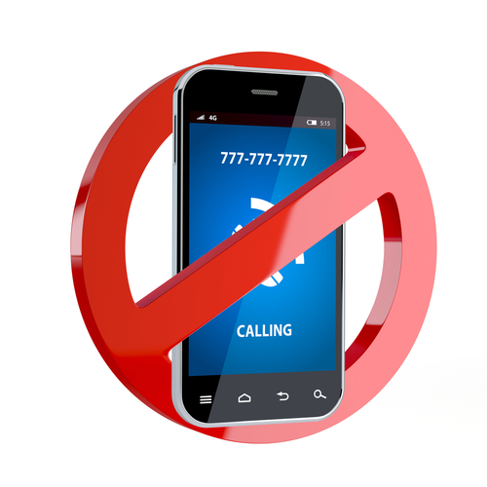
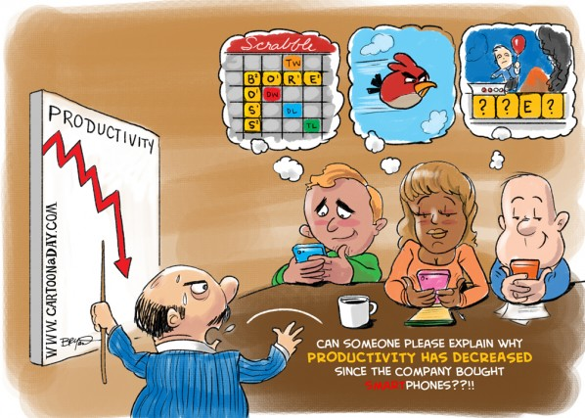
Appropriate cell phone usage times
will be communicated clearly to students!

Slide 13
Thank You!
Reach out to me…
anytime!
Ken

